Slide 1
Autonomous Cars
Daria Zahaleanu

Slide 2


Slide 3
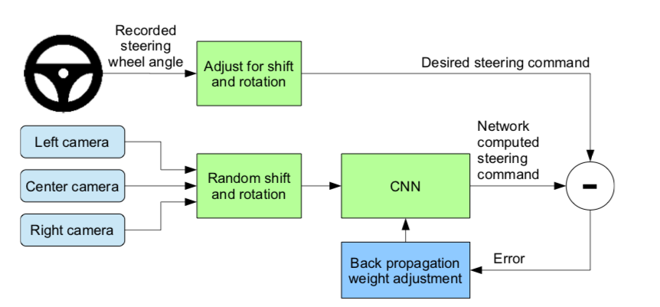
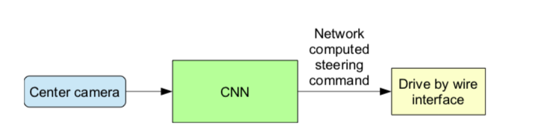
Training Mode
Autonomous Mode

Slide 4
Black-Box Attacks
in black-box attacks, the adversary doesn’t have any knowledge about the model, except for the the labels
the goal is to produce a minimal perturbation to input X, sufficient to determine the DNN to misclassify it, but imperceptible enough for the human eye
Notes:
Unlike the other two type of attacks, classified as white-box attacks, as the adversary has full access to the internal structure of the classifier, in black-box attacks, the adversary doesnâ€™t have any knowledge about the model, except for the the labels, the allow him/her access to the output only. The goal is as we previously saw, to produce a minimal perturbation to input X, sufficient to determine the DNN to misclassify it, but imperceptible enough for the human eye. The approach to this type of attack is as following: use DNN as an orale to synthesized data and generate a synthetic data set S0 to build a model F that approximates the oracleâ€™s decision. Then using the new architecture F to craft adversarial samples, the oracle outputs a misclassified probability vector, corresponding to input X*. This step, called substitute DNN training algorithm, ends with the Jacobian-based dataset augmentation, which generates a new set of data S (Figure 7). Once the adversary training a substitute DNN, it uses it to craft adversarial samples, by using two types of algorithms: Goodfellow, or the fast gradient sign method and Papernot. Therefore, the black-box attack generalizes to machine learning models that are not necessarily DNNs, regardless of the differentiability of the functions.

Slide 5
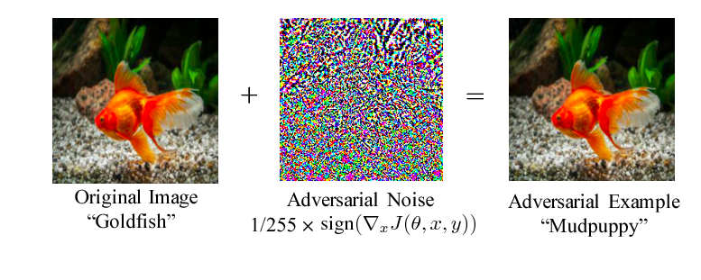
Pixel Attack
Notes:
The black-box attack requires only the probability labels (the probability value for each category) that get outputted by the neural network.

Slide 6
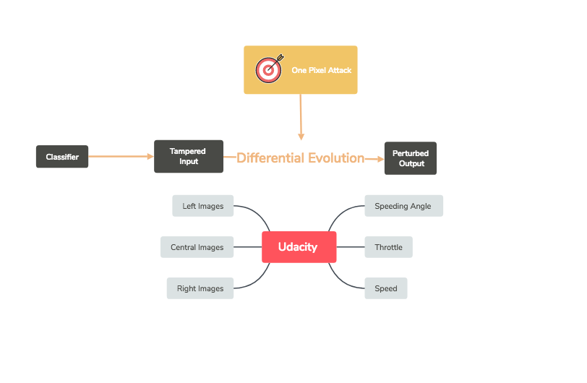
Notes:
Diff evolution = evolutional algorithm, that works with complex numbers; during each iteration another set of candidate solutions (children) is generated according to the current population (fathers). Then the children are compared with their corresponding fathers, sur- viving if they are more fitted (possess higher fitness value) than their fathers. In such a way, only comparing the father and his child, the goal of keeping diversity and improving fitness values can be simultaneously achieved.

Slide 7
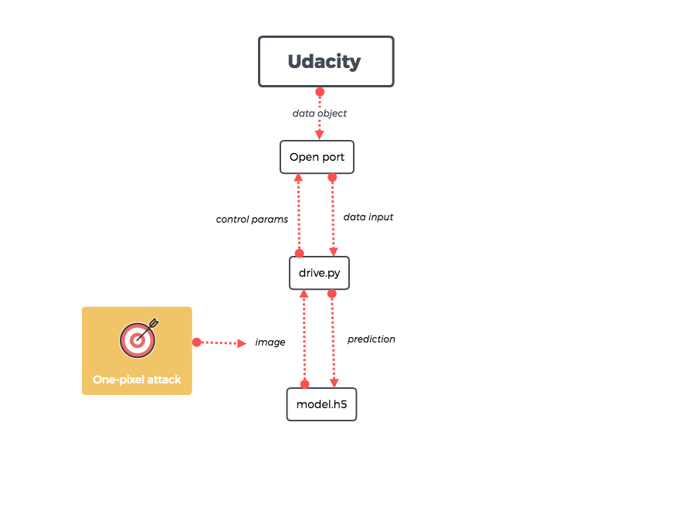

Slide 8
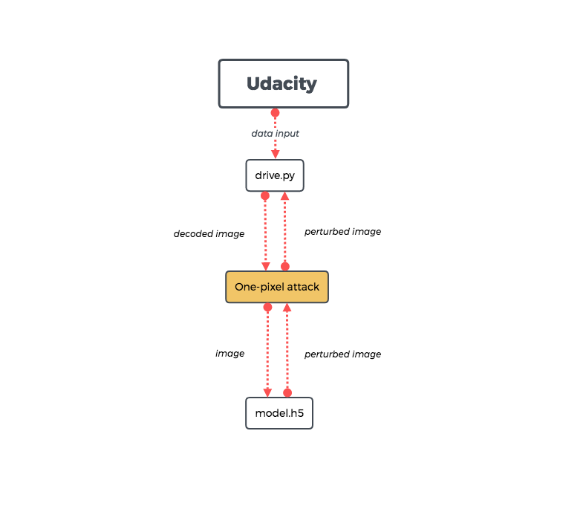

Slide 9
Differential Evolution
= function that encodes the perturbation into an array which is optimized through differential evolution
Notes:
= approximates the minimum of the

Slide 10
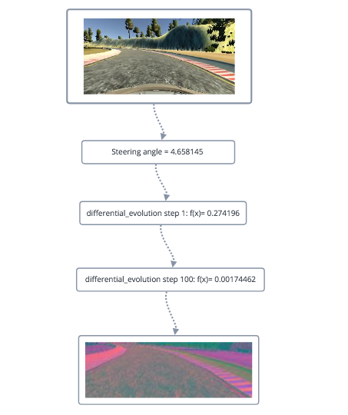
Attack on the steering angle prediction

Slide 11
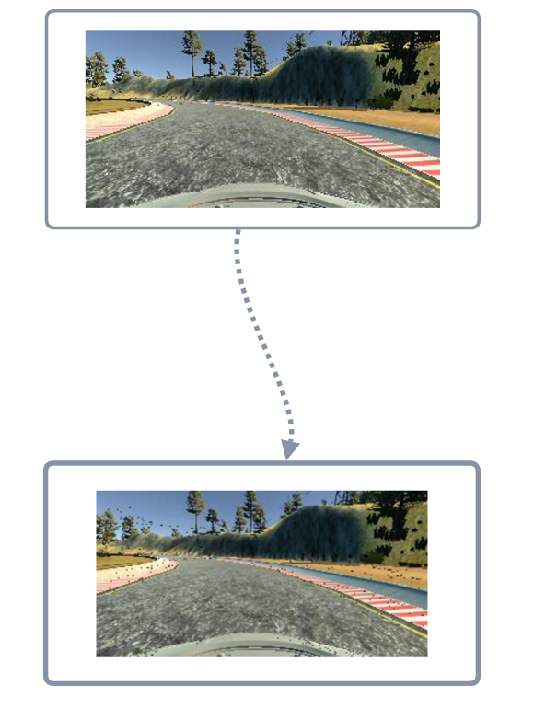
One pixel attack

